Slide 1
Baseline behavior of tubulated and detubulated model with differentially clamped Nai

Slide 2
Intracellular Nai with frequency
Force - Frequency relationship
Values obtained by averaging over 5 beats at steady state

Slide 3
Calcium transients

Slide 4
L – Type current
The trend in peak L-Type current mirrors the trend in diastolic intracellular calcium
RyR Flux

Slide 5
SERCA Flux
Na-Ca Exchanger

Slide 6
Calcium transients at 1Hz in detubulated model, with Nai clamped 10 mM

Slide 7
Calcium transients at 2Hz in detubulated model, with Nai clamped 13.5 mM

Slide 10
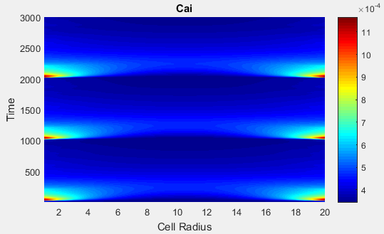
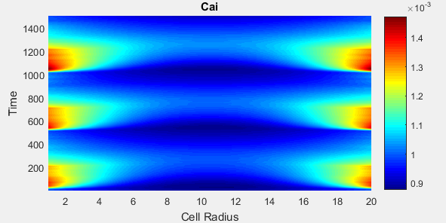
1 Hz
Simulated Line Scans
2 Hz

Slide 11
Lowering the ksat to decrease diastolic calcium in tubulated and detubulated models

Slide 12
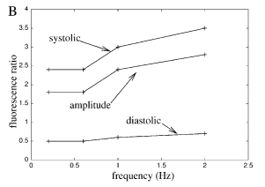
Ksat = 0.5X
Experimental (Rat)

Slide 15
Ksat = 0.2 X
Experimental (Rat)

Slide 16
Ksat = 0.2 X

Slide 17
Lowering Ksat in the Detubulated model

Slide 18
Baseline model with no changes to parameters and only detubulation
Myocyte
Purkinje

Slide 19
Ksat = 0.2X
Myocyte
Purkinje

Slide 20
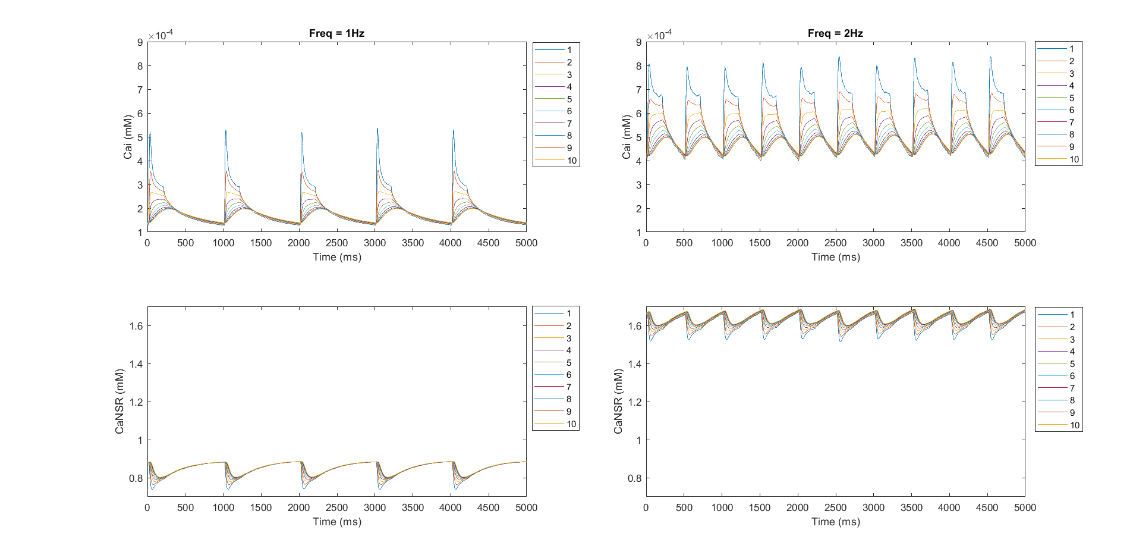
Ksat = 0.2X

Slide 21
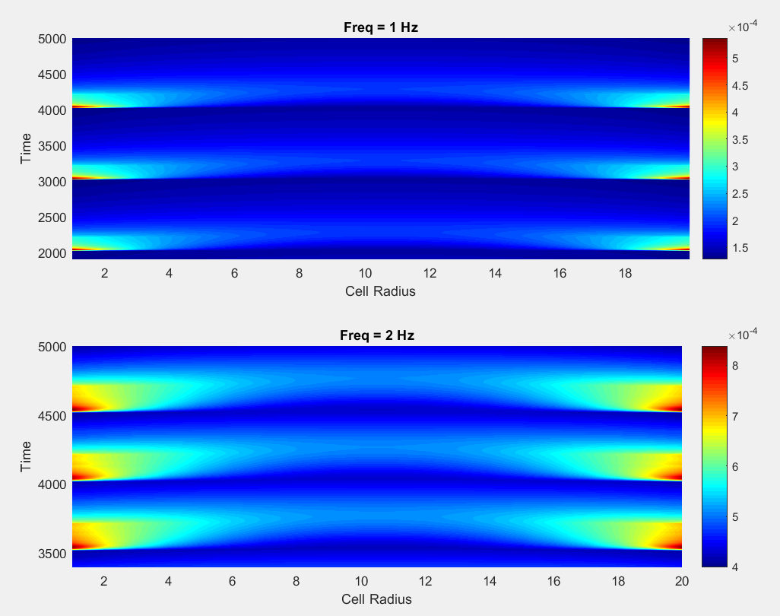
Ksat = 0.2X

Slide 22
Ksat = 0.5X
Myocyte
Purkinje

Slide 23
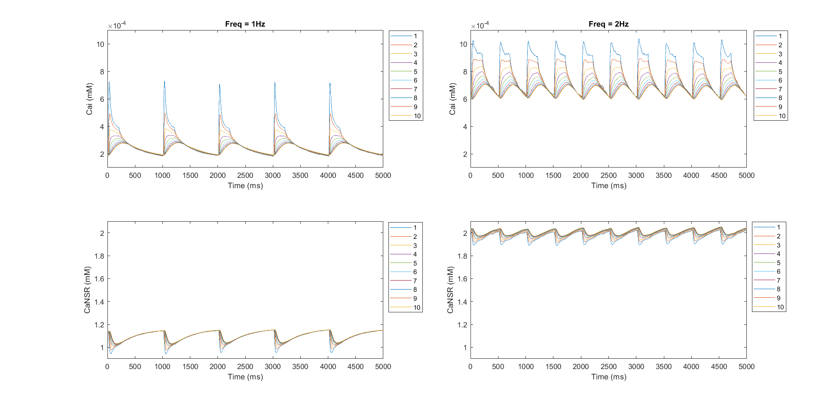

Slide 24
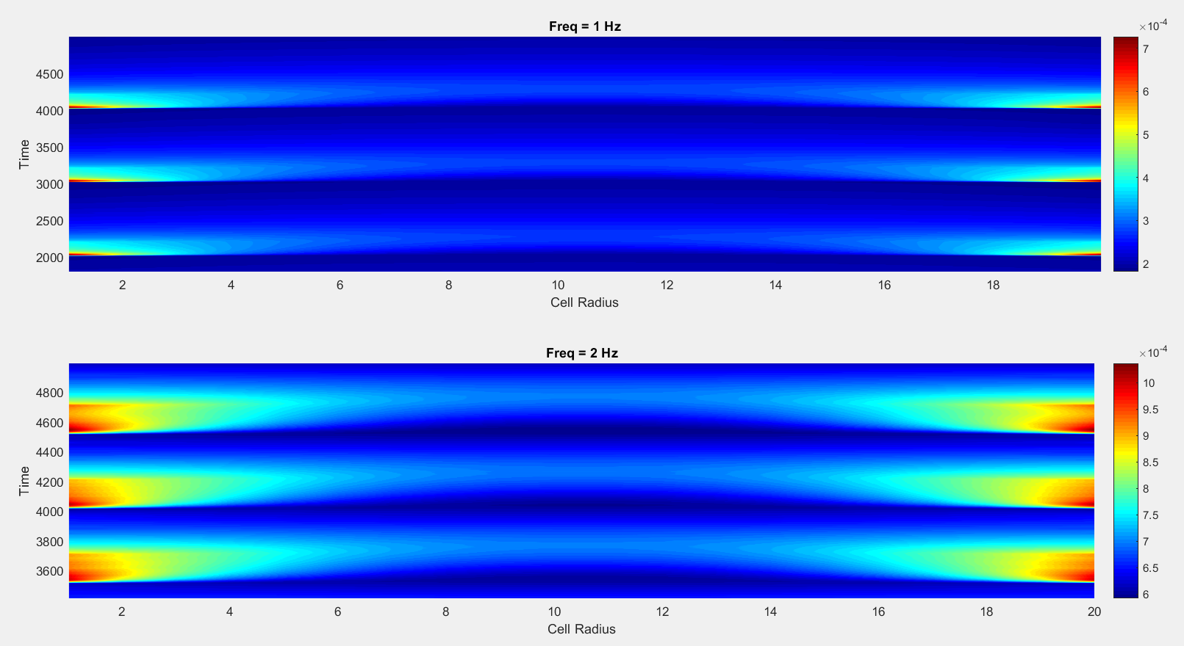

Slide 25
Modifying the internal SR volume to study its impact on diastolic calcium

Slide 26
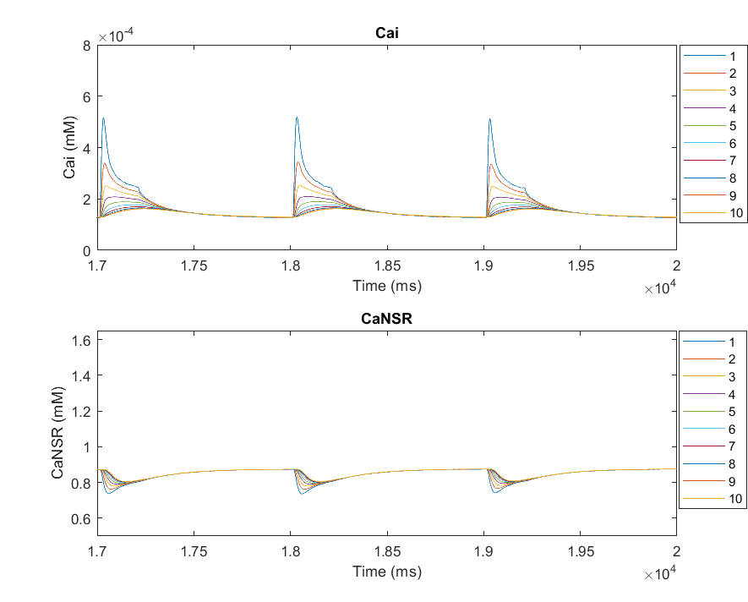
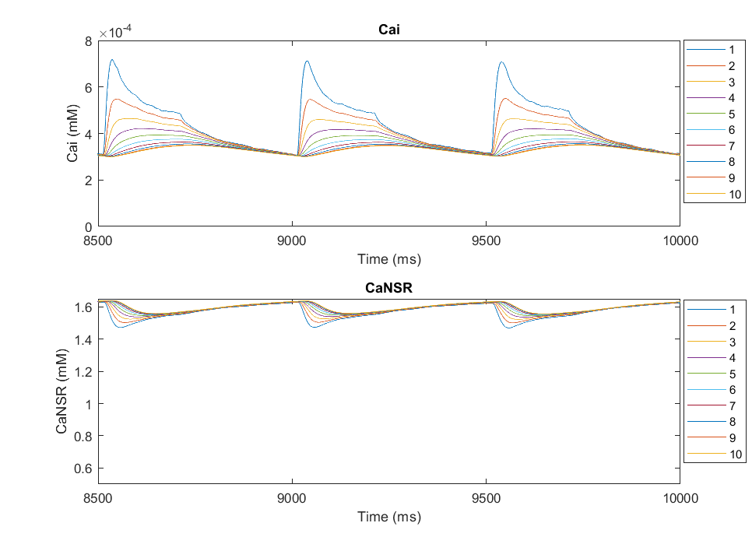
Internal SR volume 1.4 X NCX baseline
1Hz
2Hz

Slide 27
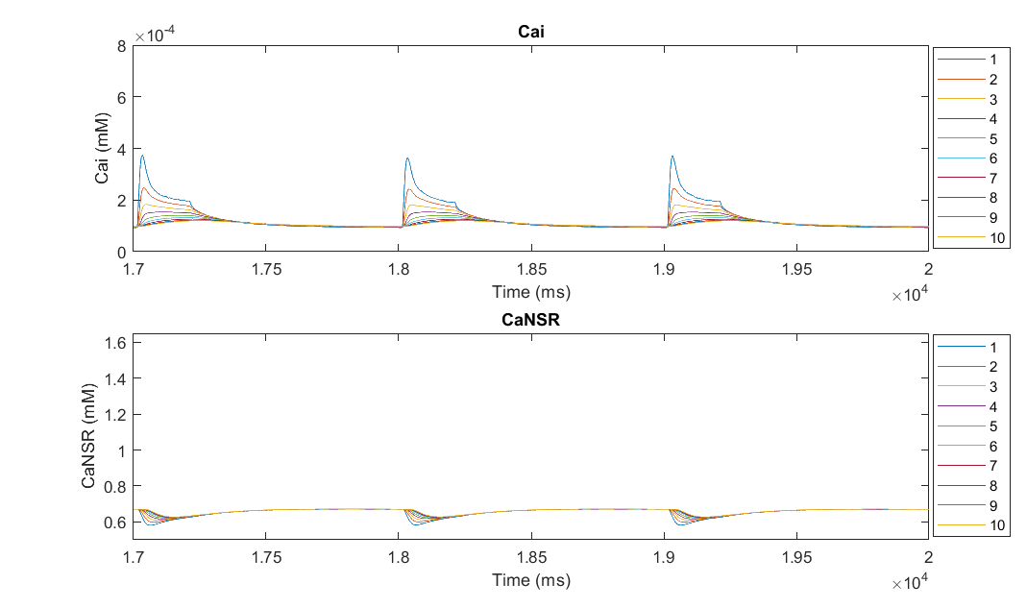
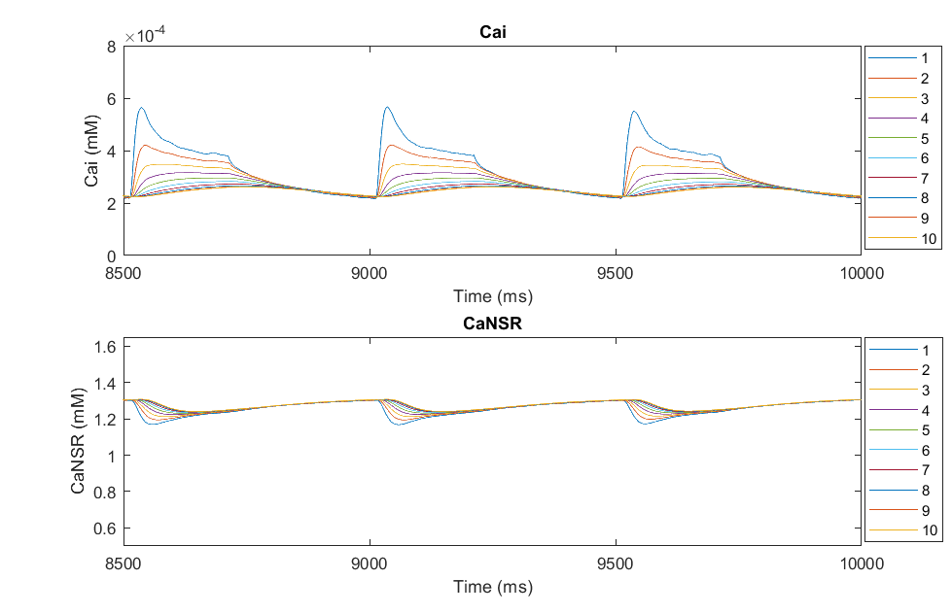
Internal SR volume 1.4 X NCX modified, Ksat = 0.2
1Hz
2Hz

Slide 28
Force Frequency relationship

Slide 29
L- Type Trigger and RyR release

Slide 30
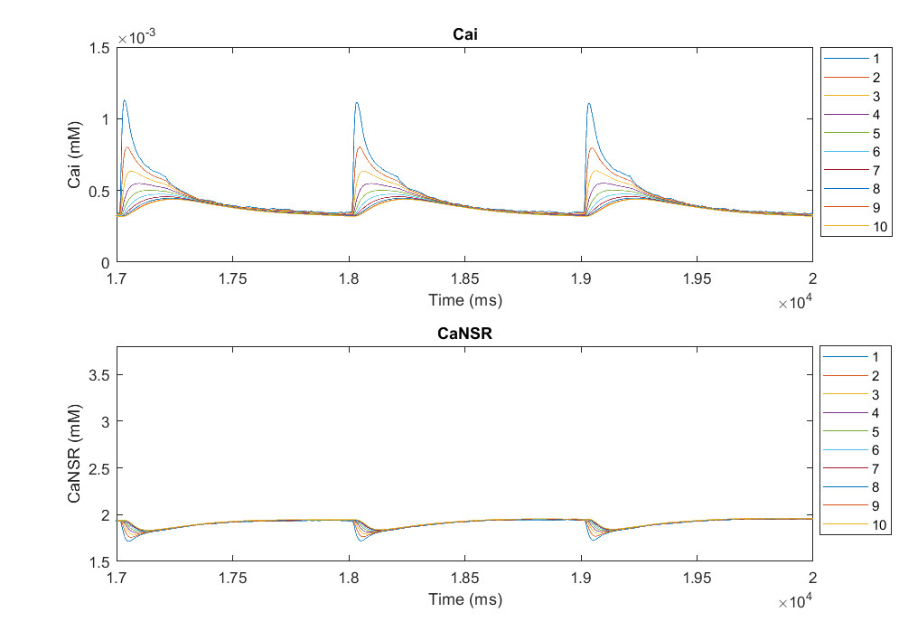
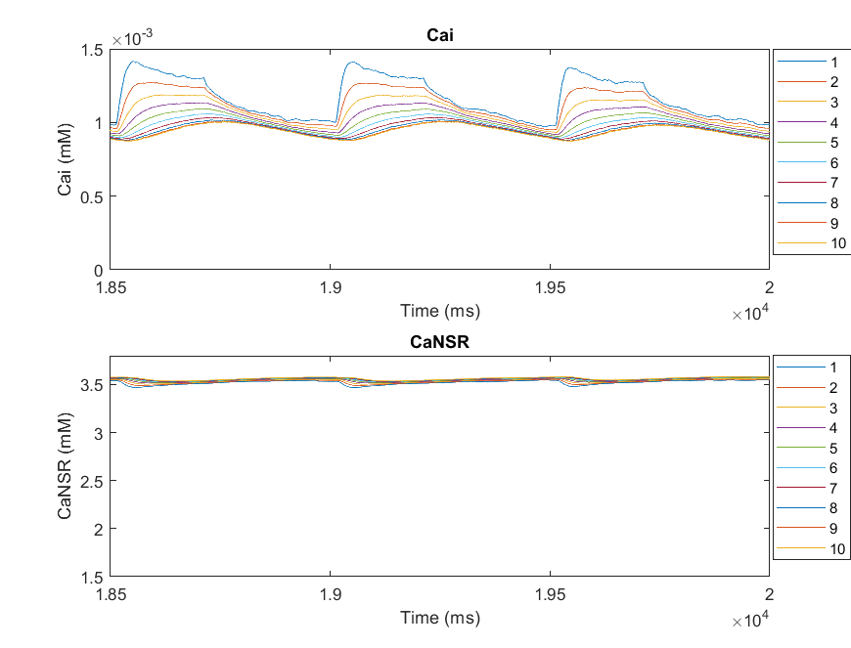
Total SR volume 1.4 X NCX baseline
1Hz
2Hz

Slide 31
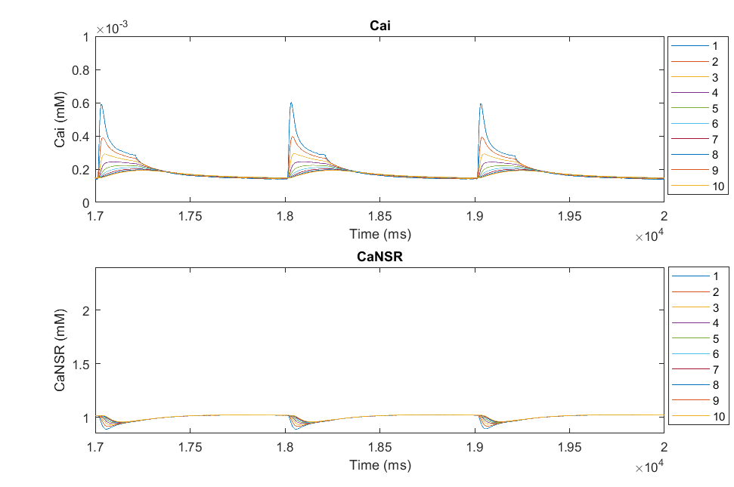
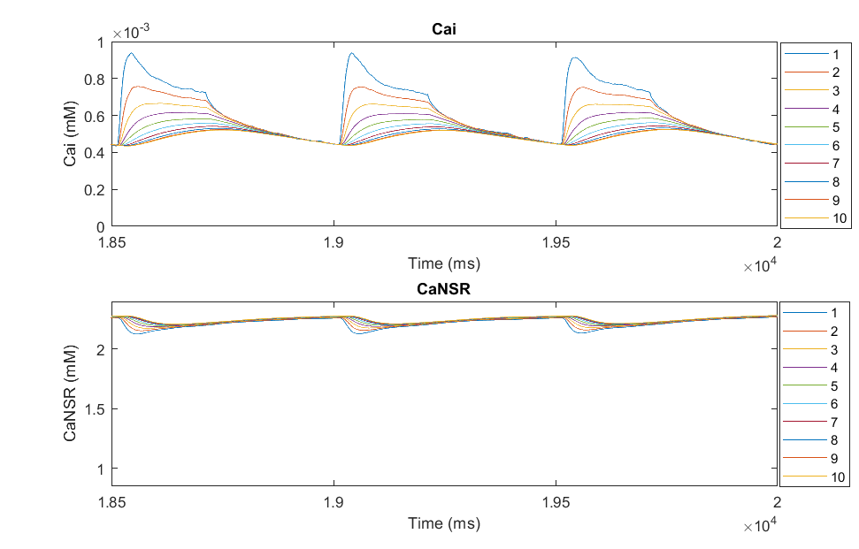
Total SR volume 1.4 X NCX modified, Ksat = 0.2
1Hz
2Hz

Slide 32
Force Frequency relationship

Slide 33
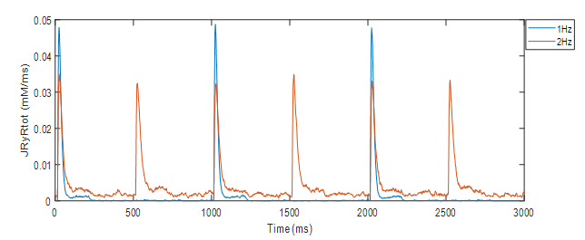
L- Type Trigger and RyR release

Slide 34
Increasing Ksat as opposed to decreasing it with interior SR at 1.4 X
Ksat was pre-multiplied by a factor of 1.4

Slide 35
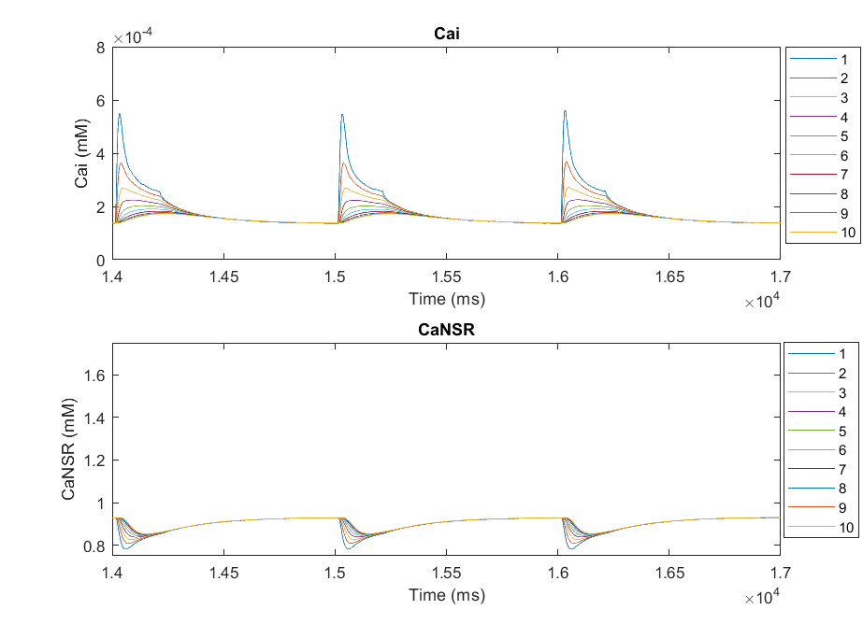
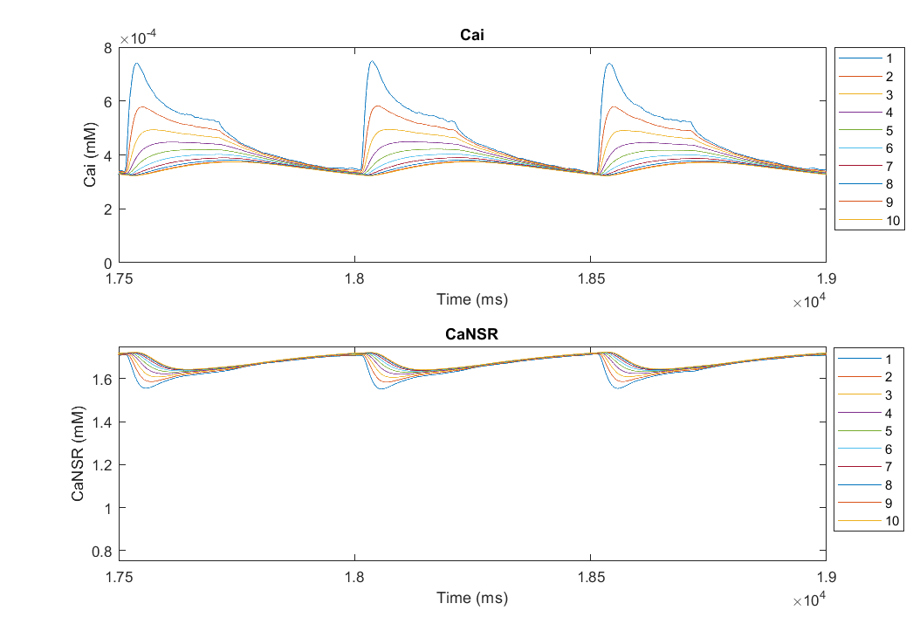
1Hz
2Hz

Slide 36
Force Frequency relationship

Slide 37
L- Type Trigger and RyR release

Slide 38
Baseline Ksat
Ksat = 1.4X

Slide 39
Baseline Ksat
Ksat = 1.4X

Slide 40
Behavior of tubulated and de-tubulated models with Ksat = 1.4X and interior SR volume = 1.4 X at 0.5 Hz, 1Hz, 2Hz

Slide 41
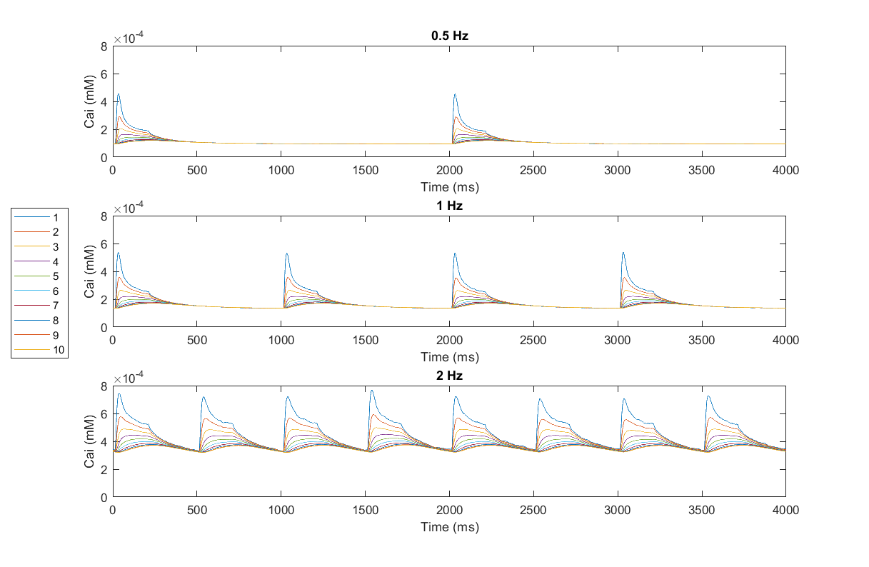
Behavior of tubulated and de-tubulated models with Ksat = 1.4X at 0.5 Hz, 1Hz, 2Hz
Myoplasmic Calcium

Slide 42
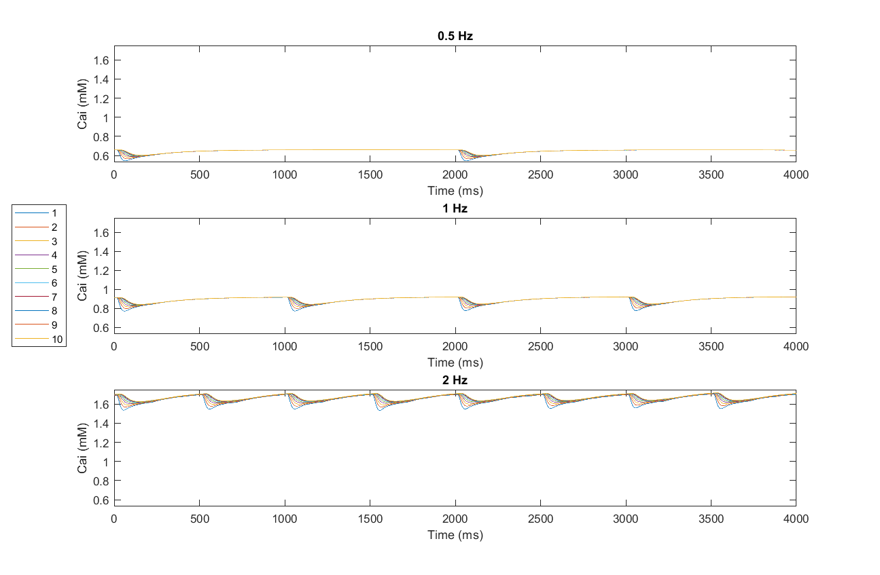
SR Calcium

Slide 43
L- Type Ca current and channel occupancy

Slide 44
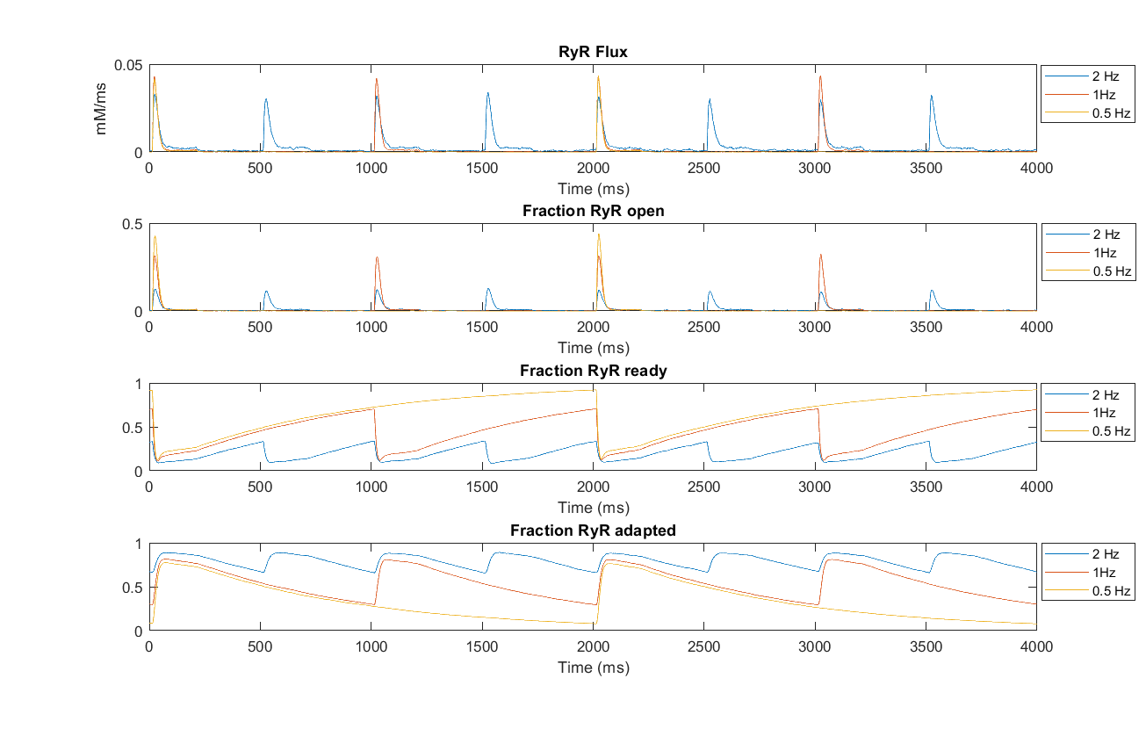
RyR release flux and receptor state

Slide 45
Tubulated
Detubulated

Slide 46
Force – Frequency relationship

Slide 47
K52 increased to 0.00667 from 0.001325 ms-1
Nai clamped at 10 mM

Slide 49
K52 increased to 0.00667 from 0.001325 ms-1
Differential Nai

Slide 51
Determinants of positive vs negative force frequency relationship (clamping) – RyR
Positive
Negative

Slide 52
Are leaky channels responsible for positive force frequency relationship ?

Slide 53
Determinants of positive vs negative force frequency relationship (clamping) – ICaL , SERCA, NCX
Positive
Negative

Slide 54
Determinants of positive vs negative force frequency relationship (with k52 increased) – RyR
Negative
Positive

Slide 55
Positive
Negative

